Slide 1
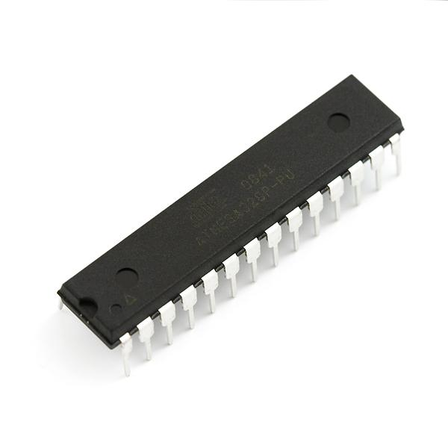
Introduction To
Microcontrollers
(Arduino &MSP430)
An intuitive look at the chips
that run modern electronics

Slide 2
Microcontrollers
What are microcontrollers, and what can be done with them?
What brands of microcontrollers exist?
The Arduino Board
The MSP430 Launchpad
TI Stellaris evaluation kits
The STM32F4 Discovery
The BeagleBone
Closing Remarks

Slide 3
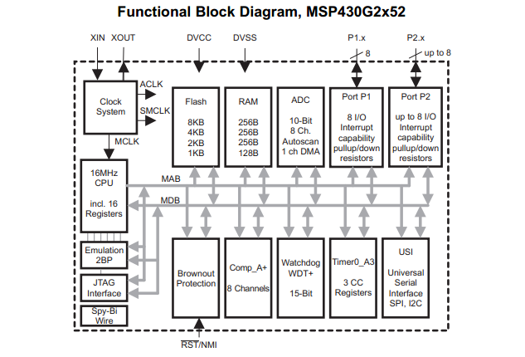
What Are These?
Microcontrollers today are single chip embedded systems
Contain most of the components necessary to perform any electronic control without thoroughly engineering a custom automation
Simply put, its a tiny computer system made to directly control digital electronics

Slide 4
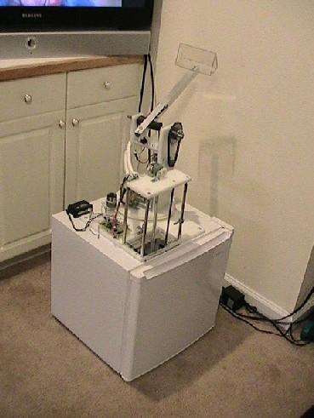
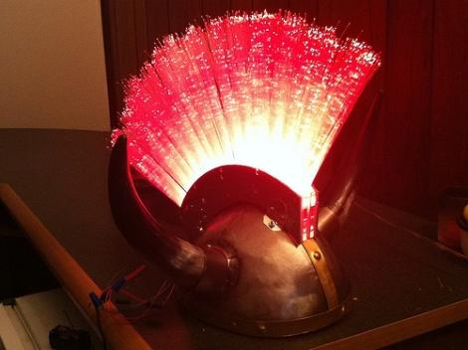
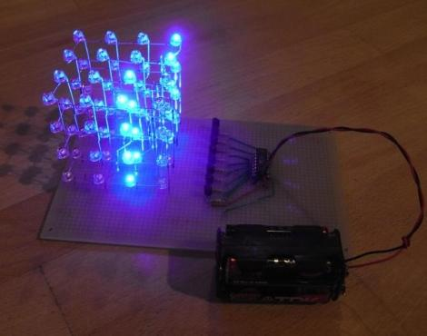
What can be done with Microcontrollers?
Short answer: anything you want
Microcontrollers can be programmed in C and Assembly to directly control pins and communications devices inside the chip, allowing motor control, light control, etc
You are limited only by your creativity

Slide 5
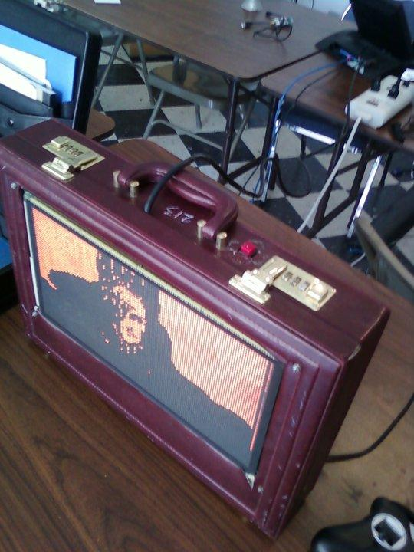
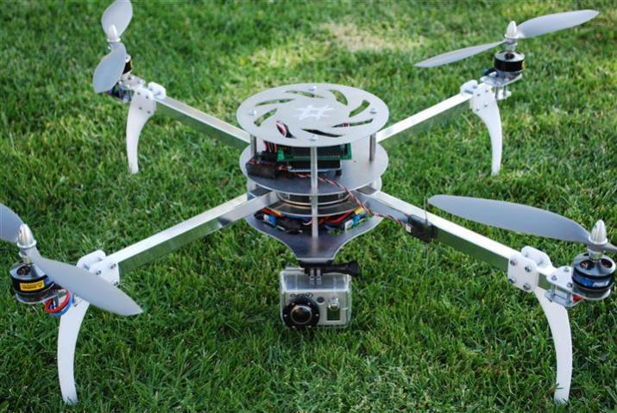
Examples of projects
Quad-copters
Home automation
Robotics
Lighting setups
Control of displays
Rotary phone keypads
Coilguns
Plotting the destruction of humanity
Ping pong ball turrets
Interfaces to hack into other electronics
Monitoring sensors and data acquisition
Musical floppy disk drives
Game controllers
Anything electronic that needs to be automatic, or controlled in some way, can be designed using a microcontroller.

Slide 6
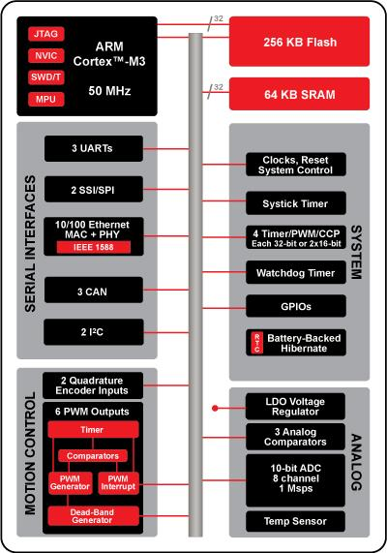
What are the Internals of a Microcontroller?
A microcontroller typically contains a CPU, some RAM, a program flash area, and a set of addressable peripherals to control the external pins
Some peripherals include analog to digital converters, serial communications, input and output on pins, timer/counters, and in some cases, ethernet controllers.
A TI Stellaris ARM-based Microcontroller

Slide 7
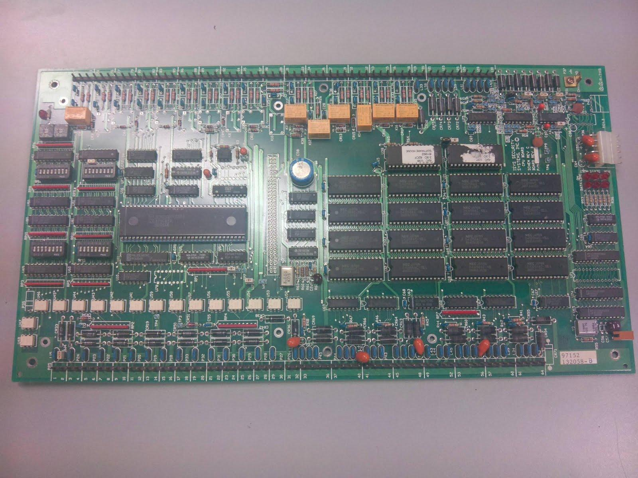
An Example of What a Microcontroller Replaces

Slide 8


Well Known Microcontrollers
Microchip's PIC line
Atmel's AVR
TI's MSP430
ARM cortex based:
TI's Stellaris
ST's STM32
Atmel's SAM
NXP's LPCxxxx
ARM MPU boards:
BeagleBone
Rasberry PI

Slide 9
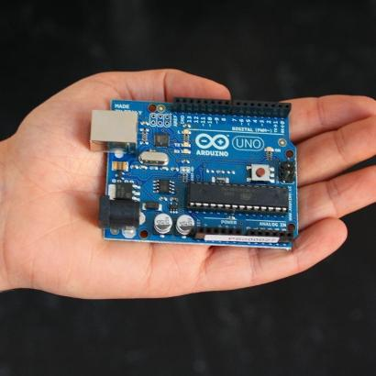
Atmel AVR Microcontrollers
Highly popular general purpose 8-bit microcontroller
Has a basic set of useful peripherals
Respectably low power consumption
Useful current drive strength (40mA @ 5V)
Great per-clock performance
Gigantic community support, its the chip in Arduino.
Programmable with the Arduino IDE, AvrStudio, GNU toolchain, IAR EW, Mikro-C.
Mature toolchain support

Slide 10

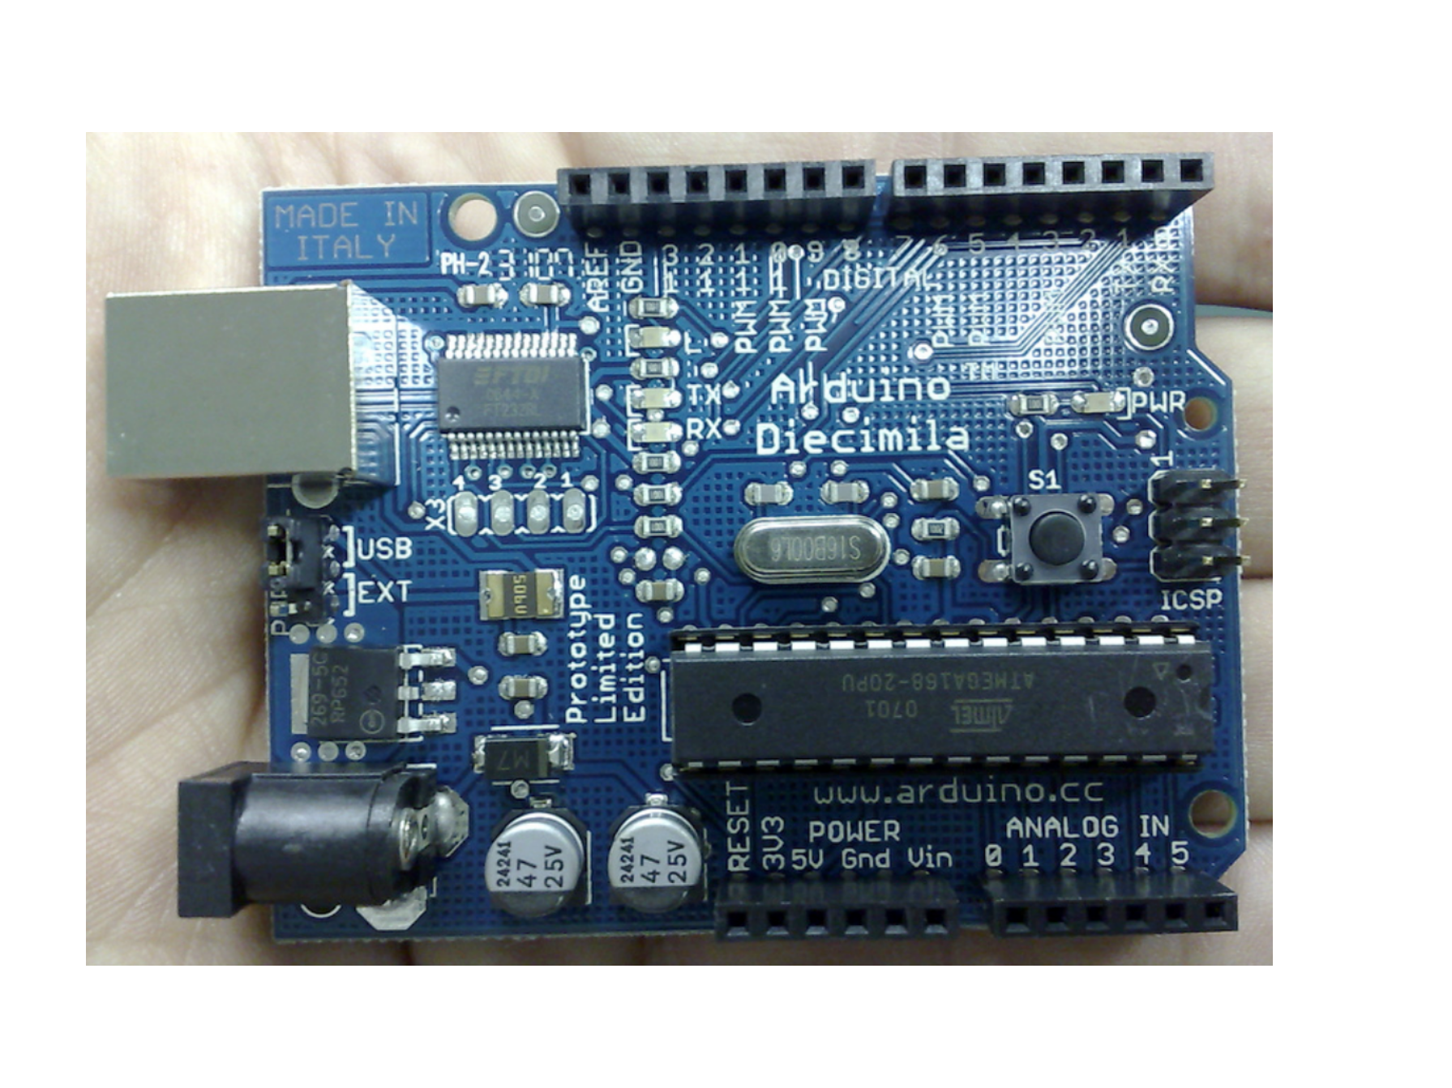
Arduino
Capabilities
=
Intel
286
Arduino

Slide 11
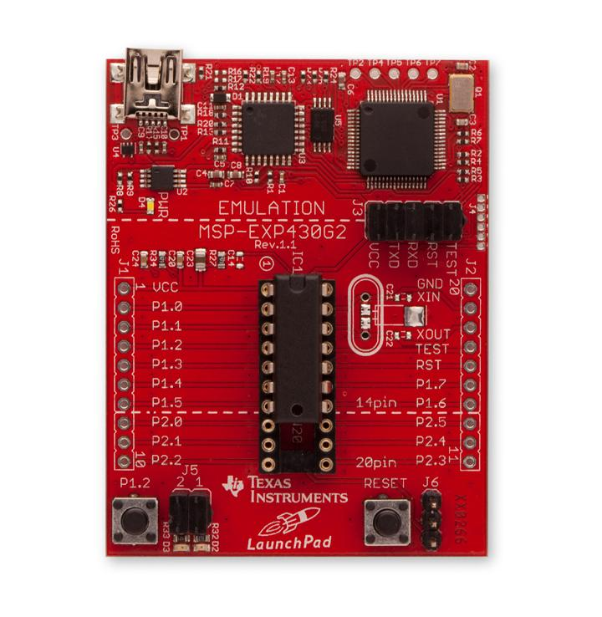
Texas Instruments MSP430
Extremely low power 16-bit microcontroller
Designed for sensors and data acquisition
Less power consumption and higher performance than AVR
Reasonably high amount of software support
Includes some of the highest quality analog peripherals I've seen
Cheap!!!
Programmed with TI's Code Composer Studio or IAR EW. Limited and neglected Linux support.
Very interesting support tools

Slide 12


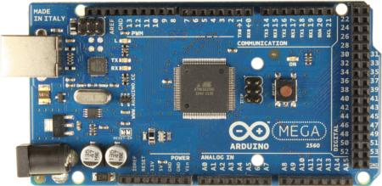
The Arduino
An AVR development board with power circuitry and a usb-serial chip designed for simple hobbyist and educational use
two major types: UNO and Mega
Arduino Uno:
Atmega328 microcontroller
32 KB of flash
2 KB RAM
20 Digital I/O Pins
6 ADC, 6 PWM
Arduino Mega 2560:
Atmega2560 microcontroller
256 KB flash
8KB RAM
70 Digital I/O pins
16 ADC, 14 PWM

Slide 13
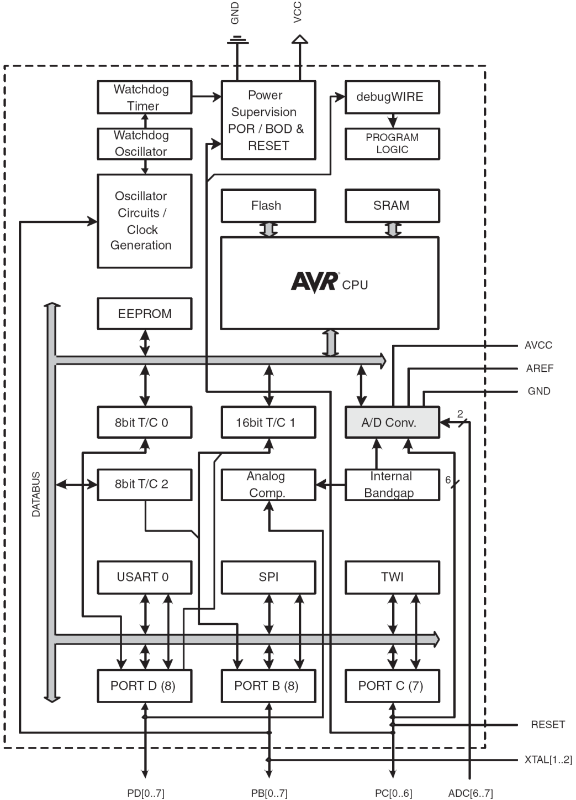
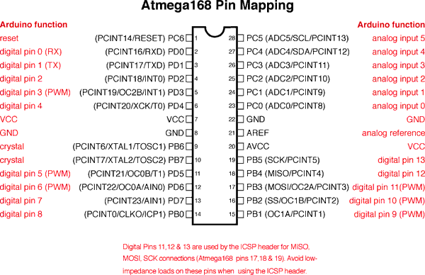
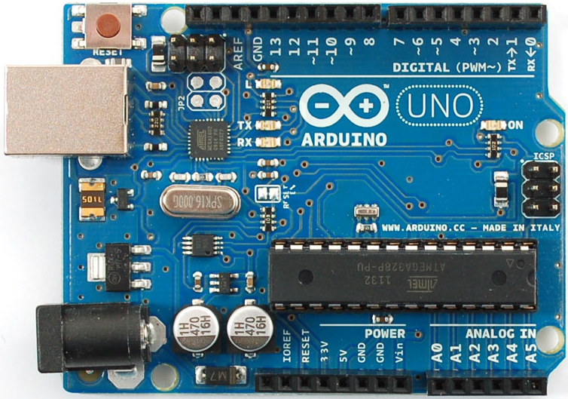
ATmega328 data sheet pp. 2, 5
http://www.adafruit.com/index.php?main_page=popup_image&pID=50
Notes:
The microcontroller is the rectangular-shaped chip, the ATmega328 (dual-inline package, DIP, shown here but surface-mount versions are available and more commonly used for cost reasons). Arduino comprises more than just the microcontroller.
Where do you go to get the details on the operation of the microcontroller? The DATA SHEET. (Show the ATmega328 data sheet).
Most of the pins have multiple functions. Note the numbering scheme and how to tell which pin is 1. Pins are grouped into ‘ports’ (what happens at a Port, like the Port of Oakland? Goods flow in and out. Similarly for data/signals of a microcontroller)

Slide 14
Arduino Duemilanove/Uno Features
Microcontroller | ATmega168/328
Operating Voltage | 5V
Input Voltage (recommended) | 7-12V
Input Voltage (limits) | 6-20V
Digital I/O Pins | 14 (of which 6 provide PWM output)
Analog Input Pins | 6
DC Current per I/O Pin | 40 mA
DC Current for 3.3V Pin | 50 mA
Flash Memory | 16 KB (ATmega168) or 32 KB (ATmega328) of which 2 KB used by bootloader
SRAM | 1 KB (ATmega168) or 2 KB (ATmega328)
EEPROM | 512 bytes (ATmega168) or 1 KB (ATmega328)
Clock Speed | 16 MHz
http://www.arduino.cc/en/Main/ArduinoBoardDuemilanove

Slide 15
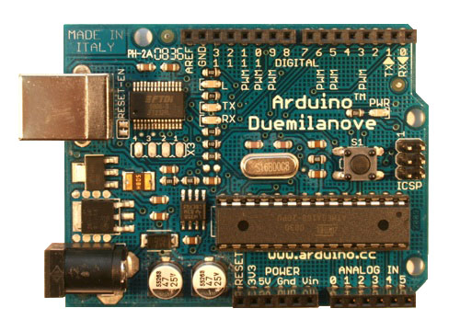
Arduino Duemilanove
http://www.arduino.cc/en/Main/ArduinoBoardDuemilanove
See the handout: Arduino_ATmega328_pin_mapping_and_schematic
Pin 13 LED
Digital pins header
USB connector
Reset button
ATmega328 MCU
Barrel jack
Analog pins header
Power-ground header
http://arduino.cc/en/uploads/Main/ArduinoDuemilanove.jpg

Slide 16
PROs / CONs
PRO
Very simple, very popular AVR based development board
Arduino library is quick to learn and easy to use
Perfect starting point for anyone learning microcontrollers
Massive community support, great documentation
very resilient platform
Comes with a simple IDE for programming the board
IDE works on windows, linux, and macosx
large market for "shield" expansions to increase the hardware capabilities of the board
CON
Board design makes serious in-system debugging impossible without modification
Expensive considering its construction
Library and IDE have technical limitations which hamper serious projects
Pretentious developers mock Arduino devs.

Slide 17
MSP430 Launchpad
This cheap $4.30 board is TI's attempt at making a more engineering-friendly counterpart to the arduino.
It comes with two cheap chips and a set of online educational guides
MSP430G2211
2KB flash
256 B RAM
10 I/O
MSP430G2231
2KB flash
256 B RAM
10 I/O
10 bit ADC

Slide 18
Key Features
Ultra-low-power (ULP) architecture and flexible clock system extend battery life
Low power consumption:
0.1 μ A for RAM data Retention,
0.8 μ A for RTC mode operation
250 μA /MIPS at active operation.
• Low operation voltage (from 1.8 V to 3.6 V).

Slide 19
Contd..
Zero-power Brown-Out Reset (BOR).
Enhanced libraries to benefit several applications such as capacitive touch, metering metrology, low power design and debugging
Extensive interrupt capability relieves need for polling
Flexible and powerful processing capabilities:
Seven source-address modes

Slide 20
Contd..
Four destination-address modes
Only 27 core instructions
Prioritized, nested interrupts
Large register file
Efficient table processing
Fast hex-to-decimal conversion

Slide 21

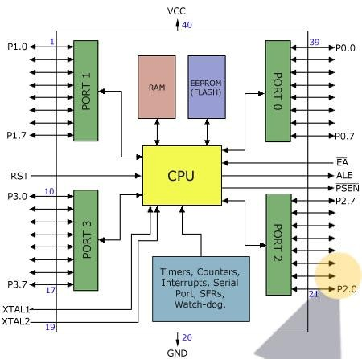


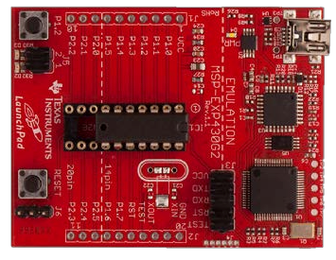
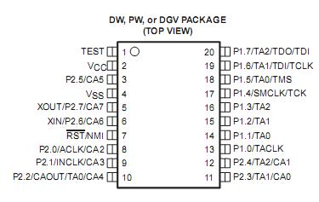
16 MHz Clock
16 KB Flash
Peripherals:
24 General-Purpose
USCI_A
UART/LIN/IrDA/SPI
USCI_B
I2C & SPI
I/O
10 bit ADC, 8 Channels
2 16 bit Timers
Temperature Sensor
BootStrap Loader

Slide 22
ARCHITECTURE
The MSP430 CPU has a 16-bit RISC architecture. The architecture of MSP430 Can be understood from the following diagram.
The controller’s performance is directly related to the 16-bit data bus, the 7 addressing modes and the reduced instructions set , which allows a shorter, denser programming code for fast execution.

Slide 23
Contd..
These MSP controller families share a 16-bit CPU core, RISC type, intelligent peripherals , and flexible clock system that interconnects using a Von Neumann common memory address bus (MAB) and memory data bus (MDB) architecture.

Slide 24
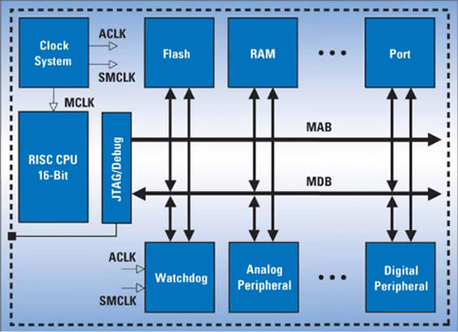
Architecture - MSP430

Slide 25
MSP430 CPU
The CPU of MSP 430 includes a 16-bit ALU and a set of 16 Registers R0 –R15.In these registers Four are special Purpose and 12 are general purpose registers . All the registers can be addressed in the same way.
The special Purpose Registers are
PC (Program Counter), SP (Stack Pointer) , SR (Status Register) and CGx (Constant Generator)

Slide 26
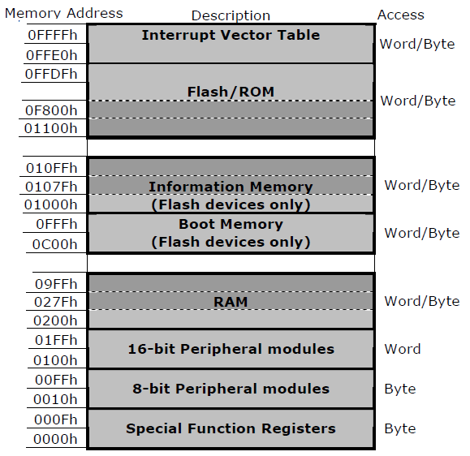

Slide 27





x2231
shown
0
0
FFFFh
FFE0h
Interupt Vector Table
◆ Flash programmable via JTAG or
In-System (ISP)
◆ ISP down to 2.2V. Single-byte or
◆ Interruptible ISP/Erase
◆ Main memory: 512 byte segments
◆ Information memory: 64 byte
⬥ Section A contains device-specific
◆ Programmable Flash Memory
FFDFh
Flash/ROM
0F800h
Word
010FFh
Information
Memory
01000h
(0-n). Erasable individually or all
027Fh
0200h
RAM
segments (A-D)
01FFh
0100h
16-bit
Peripherals
calibration data and is lockable
0FFh
010h
8-bit
Peripherals
Timing Generator
0Fh
8-bit Special Function
Registers
0h

Slide 28

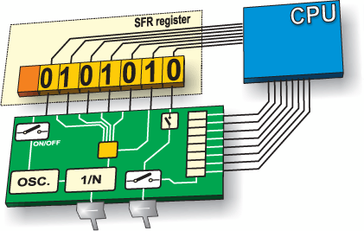
Peripherals are configured
and initialized through
memory locations known
as “special function
registers”.
Special Function registers
may also contain the
locations of the stack
pointers/interrupt
pointers/ program
counter

Slide 29


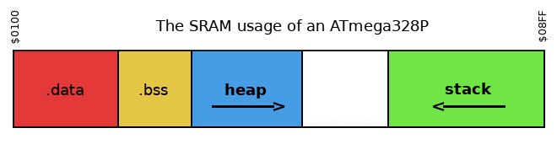
Begins at address 0x0200
Ends at
0x027F
Contains the stack, heap, .bss, and .data

Slide 30


The information memory is often used to store
calibrated application parameters which can be
updated without affecting the code stored in
the main flash memory
Linker can be modified to use this memory as code space if needed

Slide 31


Program Memory is stored here
Non-Volatile Memory
Does not erase when power is disconnected
RAM is volatile memory

Slide 32


Used to store locations of interrupt service
routines
Called when an “event” happens to execute certain code
After an analog voltage is read, stop what the processor is doing, and analyze the ADC value

Slide 33
Register Organisation
The CPU has a 16-bit ALU, four dedicated registers and twelve working registers, which makes the MSP430 a high performance microcontroller suitable for low power applications. The addition of twelve working general purpose registers saves CPU cycles by allowing the storage of frequently used values and variables instead of using RAM.

Slide 34
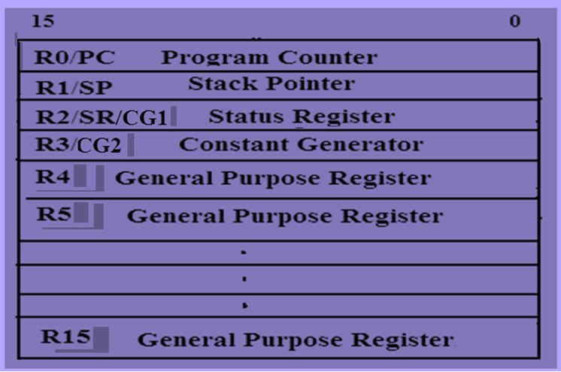
Registers

Slide 35
R1: Stack Pointer (SP)
The Stack Pointer (SP/R1) is located in R1.
Stack can be used by user to store data for later use(instructions: store by PUSH, retrieve by POP)
Stack can be used by user or by compiler for subroutine parameters (PUSH, POP in calling routine; addressed via offset calculation on stack pointer (SP) in called subroutine)

Slide 36
R2: Status Register (SR)
The Status Register (SR/R2) is a 16 bit register , and it stores the state and control bits. The system flags are changed automatically by the CPU depending on the result of an operation in a register. The reserved bits of the SR are used to support the constants generator.

Slide 37
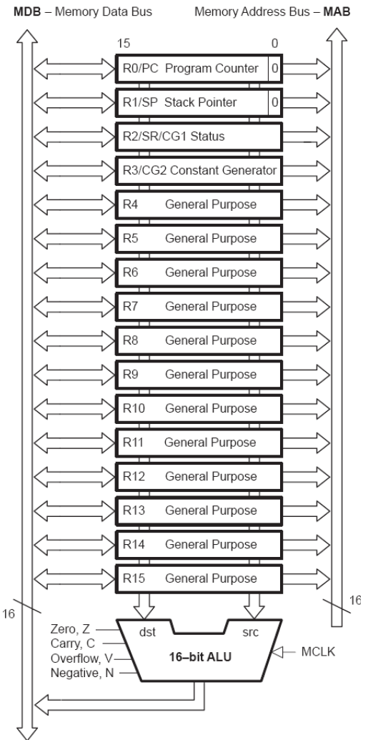
MSP430 CPU block diagram

Slide 38
R2/R3: Constant Generator Registers (CG1/CG2)
Depending of the source-register addressing modes (As) value, six commonly used constants can be generated without a code word or code memory access to retrieve them. This is a very powerful feature, which allows the implementation of emulated instructions, for example, instead of implementing a core instruction for an increment, the constant generator is used.

Slide 39
R4 - R15: General–Purpose Registers
These general-purpose registers are used to store data values , address pointers, or index values and can be accessed with byte or word instructions.

Slide 40
Low-Power Operation
The MSP430 MCU utilizes six different Low-Power Modes, which can disable unused clocks and CPU. This allows the MSP430 to sleep, while its peripherals continue to work without the need for an energy hungry processor. Additionally, the MSP430 is capable of wake-up times below 1 microsecond, allowing the microcontroller to stay in sleep mode longer, minimizing its average current consumption.

Slide 41
Flexible Clocking System
The MSP430 MCU clock system has the ability to enable and disable various clocks and oscillators which allow the device to enter various low-power modes (LPMs). The flexible clocking system optimizes overall current consumption by only enabling the required clocks when appropriate.

Slide 42
Contd..
Main Clock (MCLK) : CPU source that may be driven by the internal Digitally Controlled Oscillator (DCO) up to 25 MHz or with external crystal.
Auxiliary Clock (ACLK) : Source for individual peripheral modules driven by the internal low-power oscillator or external crystal
Sub-Main Clock (SMCLK) : Source for faster individual peripheral modules that may be driven by the internal DCO up to 25 MHz or with external crystal

Slide 43
Contd..
Low Power Modes (LPMs) represents the ability to scale the microcontroller’s power usage by shutting off parts of the MSP430. The CPU and several other modules such as clocks are not always needed. Many applications which wait until a sensor detects a certain event can benefit from turning off unused (but still running) parts of the microcontroller to save energy, turning them back on quickly when needed.

Slide 44
Contd..
So , each subsequent LPM in the MSP430 turns off more and more modules or parts of the microcontroller, the CPU, clocks etc..

Slide 45
Power modes
Active Mode : Nothing is turned off (except maybe individual peripheral modules). No power savings.
LPM0 :CPU and MCLK are disabled while SMCLK and ACLK remain active.
LPM1 : CPU and MCLK are disabled, and DCO and DC generator are disabled if the DCO is not used for SMCLK. ACLK is active.

Slide 46
Contd..
LPM2 : CPU, MCLK, SMCLK, DCO are enabled DC generator remains enabled. ACLK is active
LPM3 :CPU, MCLK, SMCLK, DCO are disabled, DC generator is disabled, ACLK is active
LPM4:CPU is disabled, ACLK is disabled, MCLK and SMCLK are disabled DCO’s dc-generator is disabled Crystal oscillator is stopped

Slide 47
Contd..
It is important to note that the parts of the microcontroller that are shut off, will not operate until they are turned on again by interrupts.

Slide 48
TIMERS
Normally we find two Timers Timer A and Timer B and one Watchdog Timer in MSP430 microcontrollers.
TIMER A: It typically has three channels and is much more versatile than the simpler timers .
Timer A can handle external inputs and outputs directly to measure frequency, time-stamp inputs, and drive outputs at precisely specified times, either once or periodically. There are internal connections to other modules so that it can measure the duration of a signal from the comparator and it can also generate interrupts

Slide 49
Contd…
Timer B : Is included in larger devices of all families. It is similar to Timer A with some extensions that make it more suitable for driving outputs such as pulse-width modulation. But , it lacks a feature of sampling inputs in Timer A that is useful in communication.

Slide 50
Watchdog Timer
The main purpose of the watchdog timer is to protect the system against failure of the software, such as the program becoming trapped in an un-intended, infinite loop. Left to itself, the watchdog counts up and resets the MSP430 when it reaches its limit.
The operation of the watchdog is controlled by the 16-bit register WDTCTL. It is guarded against accidental writes by requiring the password WDTPW = 0x5A in the upper byte.

Slide 51
Contd…
A reset will occur if a value with an incorrect password is written to WDTCTL. This can be done deliberately if you need to reset the chip from software. Reading WDTCTL returns 0x69 in the upper byte, so reading WDTCTL and writing the value back violates the password and causes a reset.
The lower byte of WDTCTL contains the bits that control the operation of the watchdog timer.
The watchdog is always active after the MSP430 has been reset. By default the clock is SMCLK, which is in turn derived from the DCO at about 1 MHz. The default period of the watchdog is the maximum value of 32,768 counts, which is therefore around 32 ms.

Slide 52






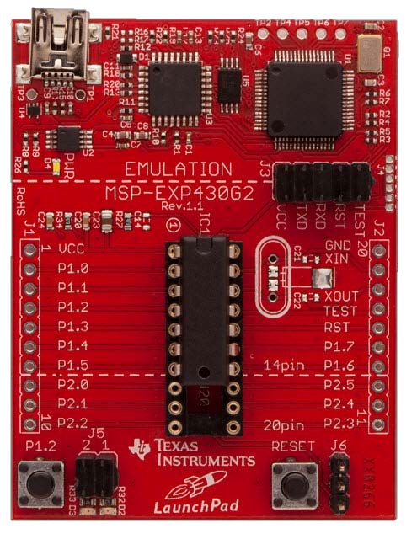
USB Emulator
Connection
Embedded Emulation
6-pin eZ430 Connector
Crystal Pads
Chip Pinouts
Part and Socket
P1.3 Button
Power Connector
LEDs and Jumpers
P1.0 & P1.6
Reset Button

Slide 53



On-Board Emulator/Debugger
Allows user to step through code line-by-line
I/O Pinouts
Allow for breadboarding or connecting TI BoosterPacks ( Sensorboards )
LEDs, Button, and Jumpers for general purpose use
Reset Switch
Jumpers to bypass debugger for serial-to-USB
communication

Slide 54


LaunchPad can be programmed using IAR, Code
Composer Studio, and Energia
IAR is a professional embedded integrated development environment (IDE) for many different microcontroller architectures
Energia is an Arduino based IDE for the
LaunchPad Boards
Easy to program
Abstracts many features from user
No debugger access

Slide 55


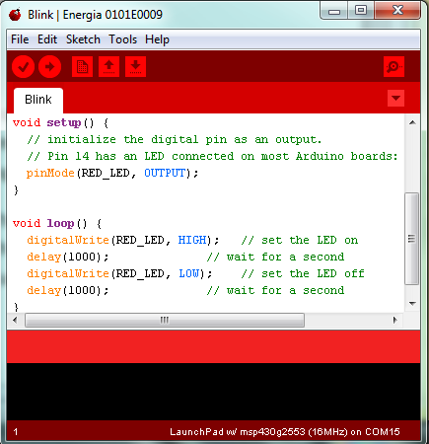

Slide 56
Code Composer Studio
TI’s custom environment
TI offers many software libraries and tools supported by code composer
More industry standard IDE unlike energia
Can be used to import Energia code

Slide 57

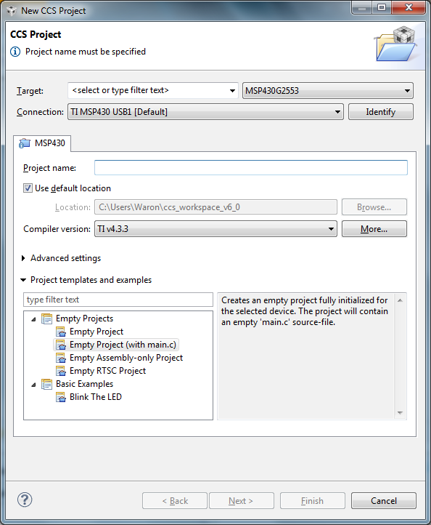
Creating a new project:
File -> new -> CCS Project
Select MSP430 G2553 in the target list
Name your Project Empty Project (with main.c) provides a
good empty code
space to start,
including code to
disable the watchdog
timer

Slide 58
Build Projects by clicking on the “hammer” icon
Compiles code, generates hex file
Load programs by clicking the “bug” icon Loads the program and sets the IDE into debug mode
Hit the green arrow “play” button to run the code

Slide 59
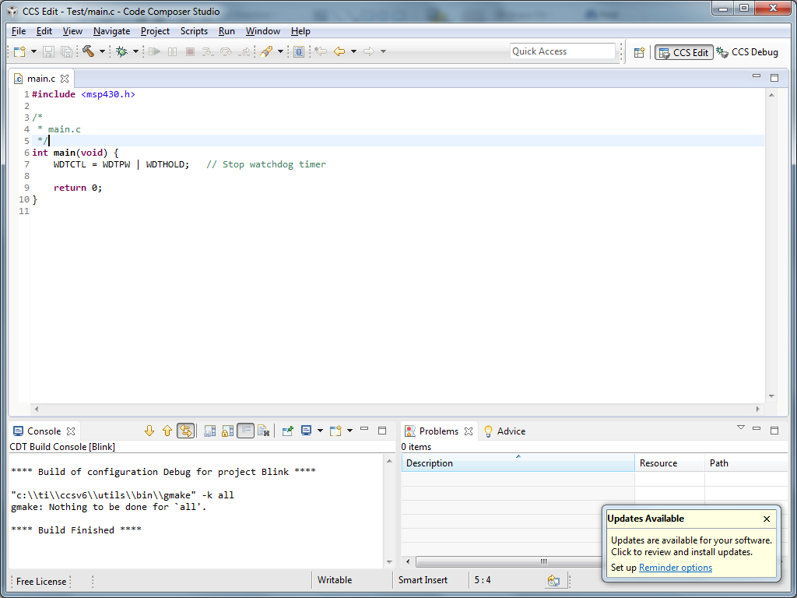

Slide 60
PROs / CONs
PRO
Very cheap
board can be used as a programmer for all MSP430 chips
Uses a full set of professional level tools
Learning platform for microcontrollers from the engineering perspective
True in-system debugging interface
CON
Much steeper learning curve
Chips supplied are lower stats than arduino
lower current drive
3.3V logic is awkward to use on the hobbyist level
IDE's are limited, but limits have no effect on chips made for the board
Windows-only support

Slide 61
Programming

Slide 62
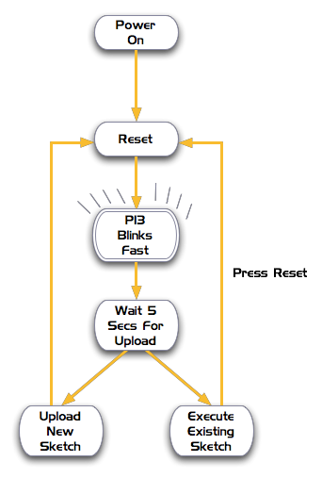

Programming
uino
Write
an
Ard
program
Compile
errors)
(check
for
Reset
board
Upload
to
board

Slide 63
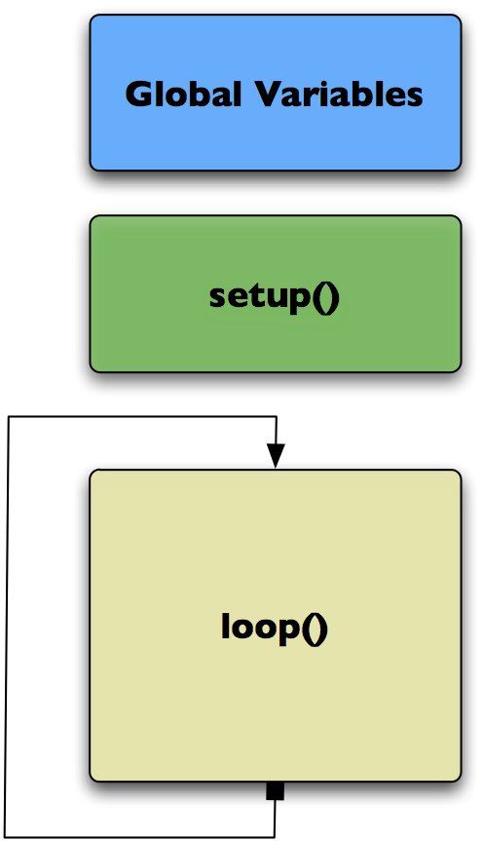

An
Arduino
“Sketch”
Declare variables
at
top
Initialize
setup() – run once at beginning,
set
pins
Running
loop() – run repeatedly, after setup()

Slide 64

An
Arduino
“Sketch”
Global Variables
int
ledPin
=
13; –
led
connected
to
control
pin
13
int
aSensor
=
0; –
setup
sensor
'aSensor'
on
analog
pin
0
int
statePin
=
LOW; –
use
this
to
hold
the
state
of
a
pin

Slide 65

An
Arduino
“Sketch”
pinMode() – set a pin as input or output
setup()
serial.Begin() – setup to `talk'
to the computer

Slide 66

An
Arduino
“Sketch”
pinMode(ledPin, Output); –
set the pin `ledPin' as an output
setup()
serial.Begin(9600); – talk to
the computer at 9600 baud rate

Slide 67

An
Arduino
“Sketch”
digitalWrite() – set a digital pin high/low
digitalRead() – read a digital pin’s state
analogRead() – read an analog pin
analogWrite() – write an “analog” PWM value
delay() – wait an amount of time
millis() – get the current tim
loop()

Slide 68
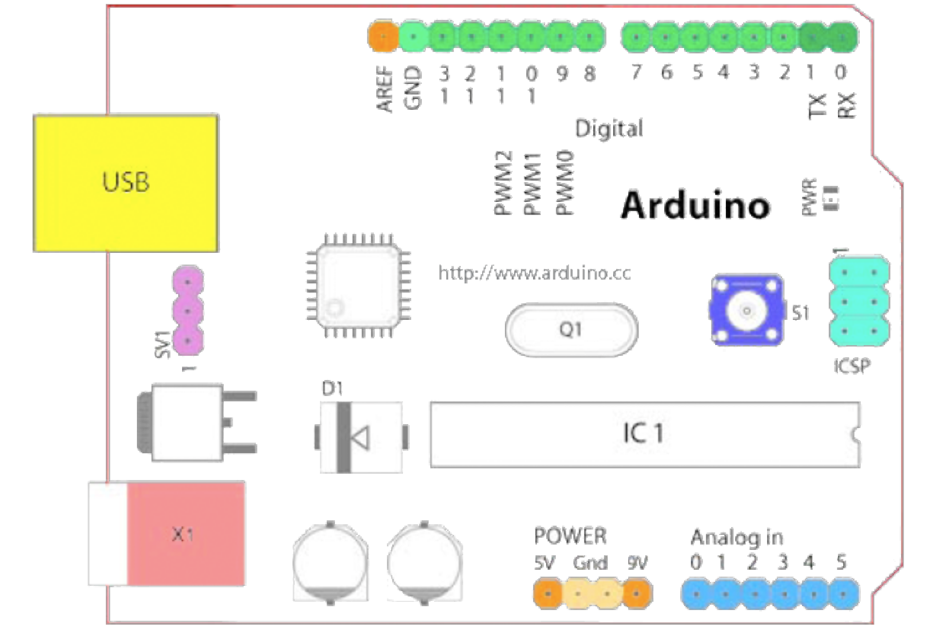
Input
/
Output
14 Digital IO (pins 0 - 13)
6 Analog In (pins 0 - 5)
6 Analog Out (pins
3, 5, 6, 9, 10,
11)

Slide 69
Digital
?
Analog
?
Digital
–
only has
two
values: on/off
Analog
–
has
many
(infinite)
values
Computers
don’t really
do
analog
-
use
quantization
instead

Slide 70
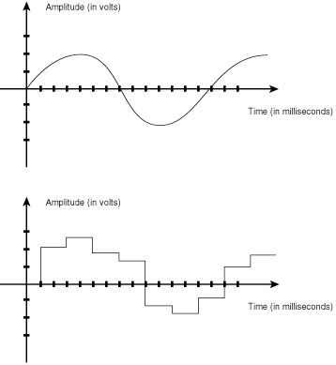
Digital
?
Analog
?
Many
states
(Analog)
or
just
two
(HIGH/LOW
-
Digital)
Number
resolution
of
states
(or “bins”)
is
Common
computer
resolutions:
8-bit = 256 states
16-bit = 65,536 states
32-bit = 4,294,967,296 states

Slide 71
IO
to/from
what?
Actuators
Solenoid
Sensors
LDR
/
IR
/
Switch
Potentiometer
/
Stepper
Motor
Joystick
/
Piezo
Accelerometer
Ultrasonic
Indicators
Other
Circuits
Prototype
shields
Special
ICs
LED
/
Lamps
Buzzers

Slide 72
/* Blinking LED ---
* turns on and off a light emitting diode(LED) connected to a digital
* pin, based on data coming over serial
*/
int ledPin = 13; // LED connected to digital pin 13
int inByte = 0;
void
{
}
setup()
pinMode(ledPin, OUTPUT); // sets the digital pin as output
Serial.begin(19200); // initiate serial communication
void
{
}
loop()
while (Serial.available()>0) {
}
if
}
}
inByte = Serial.read();
(inByte>0) {
digitalWrite(ledPin, HIGH); // sets the LED on else {
digitalWrite(ledPin, LOW); // sets the LED off

Slide 73
Experimentation

Slide 74
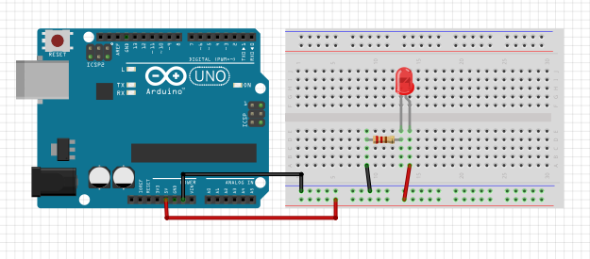
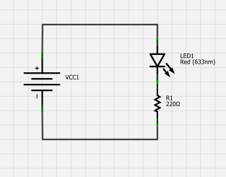
Simple Layout
Connect the power bus first.
Add the LED and resistor.
Connect them to the power bus.

Slide 75
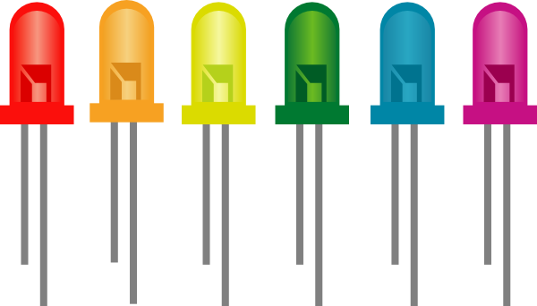
Don’t Blow It Up
An LED needs about 1.4 volts to light up.
An LED should run at around .02 amps.
If you put 5V into an LED, it could burn out.
We’ll need a resistor to reduce the voltage and ensure adequate current.
5V - 1.4V = 3.6V
I = E / R is the same as R = E / I
R = 3.6 / .02 = 180 ohms

Slide 76
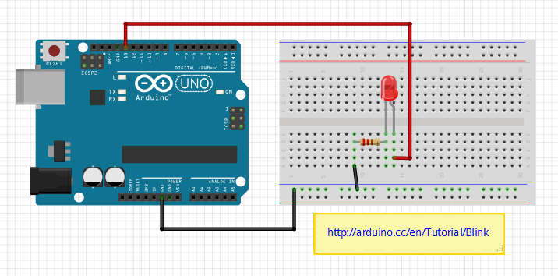
Blinky LED Layout
Move the red wire from 5V to pin 13.

Slide 77
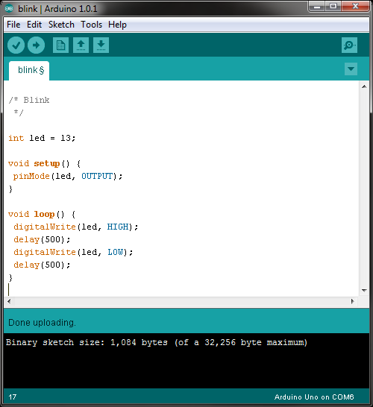
Blinky LED Code
What happens if you move the red wire to 5V and the black to pin 13.

Slide 78
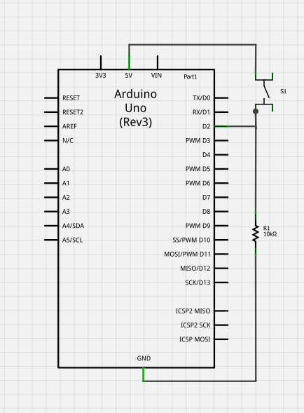
Button Schematic
We’ll light up the internal LED when the switch is pushed.

Slide 79
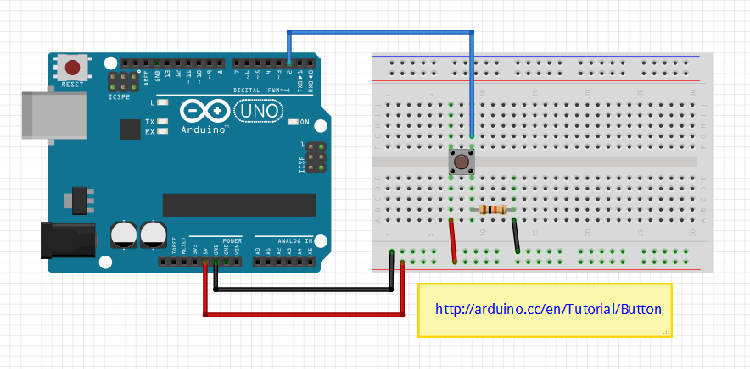
Button Layout
Why the 10K resistor?

Slide 80
Button Code
/* Button
*/
const int buttonPin = 2; // the number of the pushbutton pin
const int ledPin = 13; // the number of the LED pin
int buttonState = 0; // variable for reading the pushbutton status
void setup() {
pinMode(ledPin, OUTPUT);
pinMode(buttonPin, INPUT);
}
void loop() {
buttonState = digitalRead(buttonPin); // read the state of the pushbutton value
if (buttonState == HIGH) {
digitalWrite(ledPin, HIGH);
}
else {
digitalWrite(ledPin, LOW);
}
}
You can make this code a lot shorter!

Slide 81
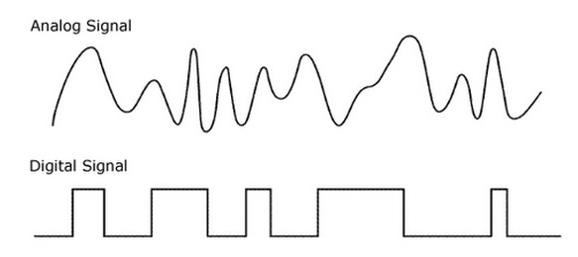
Analog vs. Digital
Analog outputs are expensive!

Slide 82
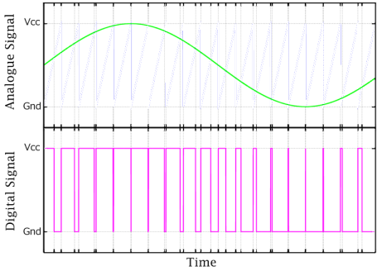
Analog vs. PWM Signals
PWM is cheap to implement!
Notes:
An optional slide, depending on the audience.

Slide 83
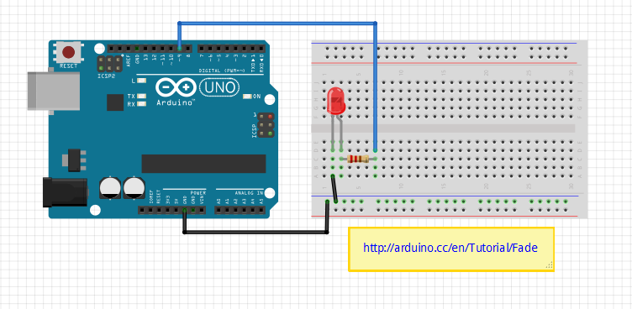
Fade Layout

Slide 84
Fade Code
/* Fade
*/
int led = 9; // the pin that the LED is attached to
int brightness = 0; // how bright the LED is
int fadeAmount = 5; // how many points to fade the LED by
void setup() {
pinMode(led, OUTPUT); // declare pin 9 to be an output
}
void loop() {
analogWrite(led, brightness); // set the brightness of pin 9 (it’s not really analog)
brightness = brightness + fadeAmount; // change the brightness for next time through the loop
if (brightness == 0 || brightness == 255) { // reverse the direction of the fading at the ends of the fade
fadeAmount = -fadeAmount ;
}
delay(30); // wait for 30 milliseconds to see the dimming effect
}

Slide 85
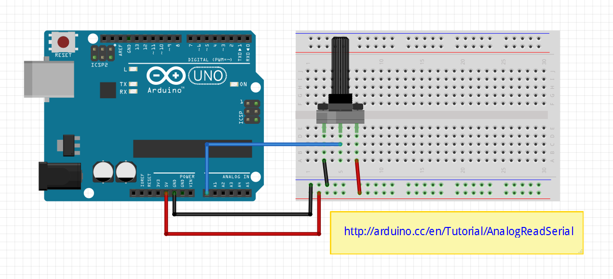
Analog Read Layout

Slide 86
Analog Read Code
/* Analog Read */ void setup() { Serial.begin(9600); // initialize console output at 9600 bits per second } // Press ctrl-shift-m to bring up the console void loop() { int sensorValue = analogRead(A0); // read the input on analog pin 0 Serial.println(sensorValue); // print out the value you read delay(10); // delay in between reads for stability }
The potentiometer is logarithmic while the joystick is linear.

Slide 87
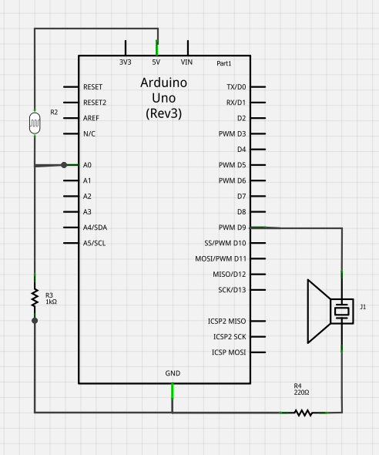
Light and Sound Schematic

Slide 88
Light and Sound Code
/* Light and Sound
*/
void setup() {
Serial.begin(9600);
}
void loop() {
int sensorReading = analogRead(A0);
Serial.println(sensorReading);
// map the analog input range (in this case, ~80 - 310 from the photo resistor)
// to the output pitch range (100 - 1000Hz)
int thisPitch = map(sensorReading, 80, 310, 100, 1000);
tone(9, thisPitch); // play the pitch on pin 9
delay(1); // delay in between reads for stability
}
Not quite the same value resistors as on the web site – so fudge it!

Slide 89
A simple program
As an example let us consider the interfacing of an LED to the port of MSP430 and blink it by writing a C program. Here we have considered two cases of active low and active high and the LED is connected to Port 2 pins of the MSP controller .The ciruits are shown in the next slide.

Slide 90
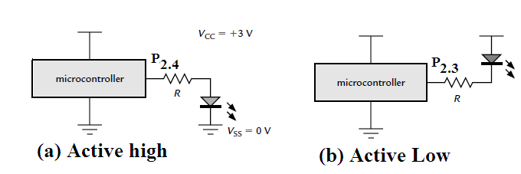
Circuits

Slide 91
Program
#include <msp430x11x1.h> // Specific device
void main (void)
{
WDTCTL = WDTPW | WDTHOLD; // Stop
watchdog timer// P2DIR = 0x18; // Set pins with LEDs to output ,
0b00011000//
P2OUT = 0x08; // LED2 (P2.4) on , LED1 (P2.3) off
active low!)//
for (;;) { // Loop forever ...
} // ... doing nothing
}

Slide 92
Explanation
The first line of C stops the watchdog timer , which would otherwise reset the chip after about 32 ms.
The two pins of port P2 that drive the LEDs are set to be outputs by writing to P2DIR. For safety the ports are always inputs by default when the chip starts up
The LEDs are illuminated in the desired pattern by writing to P2OUT. A 0 lights an LED and 1 turns if off because they are active low.

Slide 93
Tips for getting started with microcontrollers and electronics
This can be an intimidating field to get into if you don't enter in at the right point.
Recommendation:
Start off with an Arduino experimentation kit from adafruit.com
Learn how to turn lights on and off, and to read from analog devices, and get more complex with the programming
Progress forward in little steps, especially if you are learning c/c++ for the first time
Have a project Idea in mind as a goal
Youtube is full of tutorials and demonstrations of arduino boards
Visit Hackaday and instructables to find some interesting projects
Challenge yourself as much as possible, and if you are up to it, read the chip documentation, even if none of it makes sense
AVRfreaks is a great community for expert level coding of avr controllers
DO NOT be intimidated if you start getting into big issues programming. Every learning coder goes through a phase of absolute frustration when learning for the first time.

Slide 94
A simple program
As an example let us consider the interfacing of an LED to the port of MSP430 and blink it by writing a C program. Here we have considered two cases of active low and active high and the LED is connected to Port 2 pins of the MSP controller .The ciruits are shown in the next slide.

Slide 95
Circuits

Slide 96
Program
#include <msp430x11x1.h> // Specific device
void main (void)
{
WDTCTL = WDTPW | WDTHOLD; // Stop
watchdog timer// P2DIR = 0x18; // Set pins with LEDs to output ,
0b00011000//
P2OUT = 0x08; // LED2 (P2.4) on , LED1 (P2.3) off
active low!)//
for (;;) { // Loop forever ...
} // ... doing nothing
}

Slide 97
Explanation
The first line of C stops the watchdog timer , which would otherwise reset the chip after about 32 ms.
The two pins of port P2 that drive the LEDs are set to be outputs by writing to P2DIR. For safety the ports are always inputs by default when the chip starts up
The LEDs are illuminated in the desired pattern by writing to P2OUT. A 0 lights an LED and 1 turns if off because they are active low.

Slide 98
Programming Tips
Programming is a skill, not a talent. It is learned through experience and research.
A program will do exactly what you tell it to do, not what you want it to do.
MIT tells its CS students that the most effective debugging tool in the industry is the "print" function
Always read the manual. languages are implemented differently on every platform, and all platforms behave slightly differently from each other
There is no such thing as too much documentation
Most of the work of good coding is in planning and maintenance, not the actual process of writing the code
Code first, optimize later
if a code has multiple complex things, code and test each function separately, and then include them into your main project
As with anything that is ever done in life, Keep It Simple, Stupid.

Slide 99
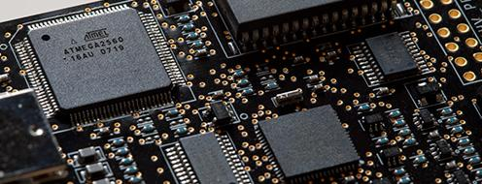

Closing Remarks
There are many microcontrollers out there of various performance levels and difficulties
These devices can be used to compute and automate the operation of almost every electronic device imaginable
Some of these small chips outperform full personal computers from the 80's and 90's
These platforms are useful for their own reasons and have their own limitations

Slide 100
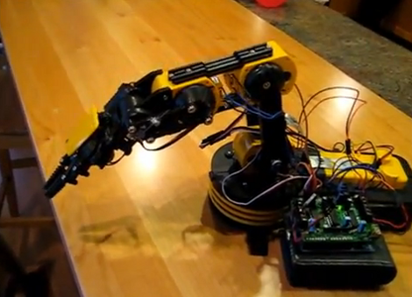
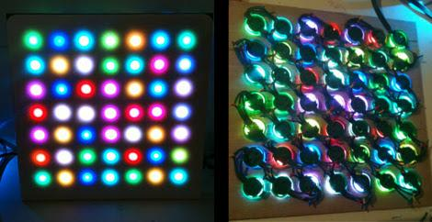








What Will You Make?

